Slide 1
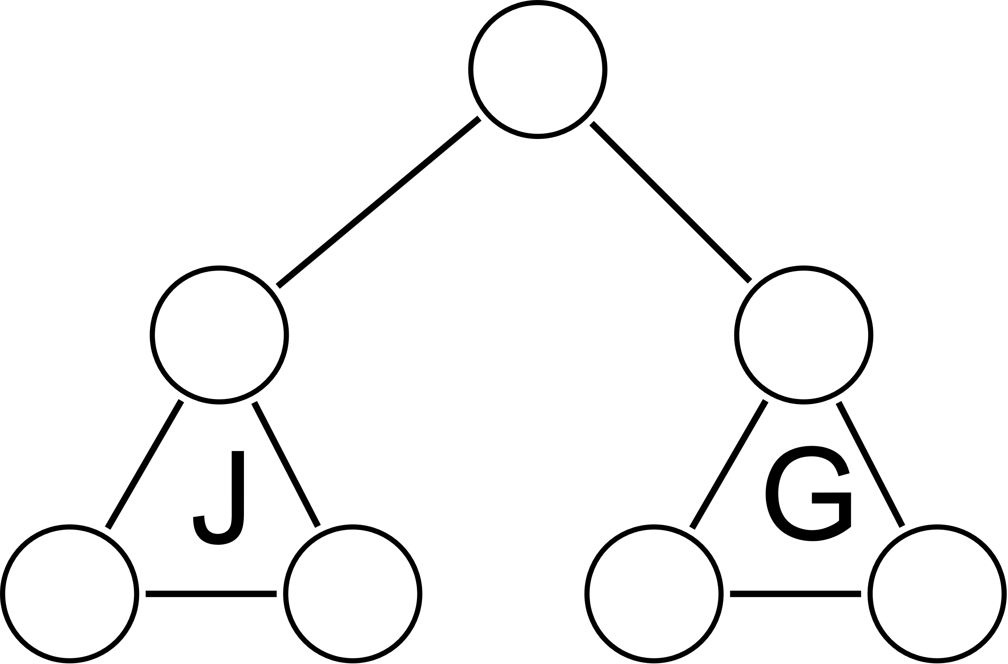
JurisGraph
“Reliable AI from reliable data“
Founder: Enrico Rampazzo
Email: enrico@jurisgraph.ai
Mobile: +971505080781

Slide 2
Meet the founders
Enrico Rampazzo
I have 13 years of experience as a full stack software engineer and have worked in different countries and industries, from Italy to UAE, from banking to embedded systems.
I have been interested in machine learning and AI since 2016 and have been experimenting with local LLMs for the last two years. In a way JurisGraph is a way to bridge my profession as a software engineer and my studies in international economics and law, and I can’t wait to make it a reality

Slide 3
Meet the founders
Yiwern Lee
I am a seasoned tax professional with expertise in international taxation across various regions. Succefully built-up regional tax functions, currently overseeing Middle East, Africa & Pakistan region's tax operations for ByteDance/TikTok.
I have a rich experience in business functions build-up for startup, committed to business/tax strategy in emerging economies, developing a high performing team, and ensuring a smooth running of business operations in a fast-paced environment. Experience in GST/VAT implementation in the GCC & APAC

Slide 4
Problem
Issue: Why is it time consuming to research legal materials?
Pain point:
(1) Manual research seems inefficient and costly.
(2) Current cloud AI offerings do not reference
Opportunity: Building a SaaS that can be integrated with your AI provider of choice or used completely on-premise

Slide 5
Solutions
Product: Jurisgraph is SaaS that can be used with your preferred cloud AI provider or with a fully on-premise solution to fulfill stringent data privacy constraints
Vision: To be the world's first platform delivering trustworthy AI chatbot assistance for sensitive and confidential projects
Mission: Transforming legal research through real-time automation, empowering insights across industries from real estate, finance/ tax, legal, labor to government sectors

Slide 6
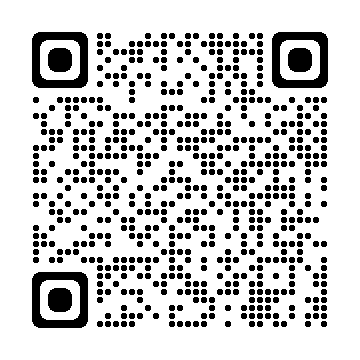
Product overview
Product Features: Provide accurate answers grounded on official sources (legislation/ official guidance). If the question is outside of this scope the model simply declares it can’t answer rather than hallucinating.
Development Stage: MVP, beta testing: an initial version of the product is available at https://jurisgraph.ai , and it includes part of the UAE legislation on Corporate Tax Law
Tech Stack: Java (Spring AI with Thymeleaf and HTMX), Neo4J (graph database), agnostic with regards to the LLM cloud providers: customers can use their existing subscription to OpenAI, Claude, DeepSeek etc.

Slide 7
Market gap
Underserved segments | Lack of affordable & reliable platform | Trust, accuracy & confidentiality | Regulatory & multilingual opportunities
Small law firms: can’t afford to pay expensive tools (e.g. LexisNexis) | High costs, free resources (e.g., government websites) are often hard to navigate. | Incorrect legal advice from AI, leading to liability risks | Cross-border law research is complex and underserved
Non-lawyers: Finance/Tax, HR, real estate (e.g. tenant rights, immigration, employment disputes, tax obligations) | Outdated user interfaces, slow performance | Can’t handle sensitive case analysis or cross-jurisdictional compliance. | Many non-English speakers struggle to find legal help
Emerging markets: digitalization in legal field – underdeveloped. | Lack of real-time updates | Not enterprise-level confidential research.
Where can I find a reliable and secure AI-powered chatbot that enables professionals to conduct real-time legal analysis and cross-sector research—especially for P&C or multilingual cases?

Slide 8
Market size & opportunity
Market revenue (2024) | USD132.6 million
Estimated market revenue (2030) | USD 402 million
Growth rate | 19.5% (CAGR from 2025 to 2030)
Historical data covered | 2018 to 2023
Base year of estimation | 2024
Forecast period covered | 2025 to 2030
Source: See Sources slide
Legal Chatbots: The global legal chatbot market was valued at approximately USD 132.6 million in 2024 and is projected to reach USD 402 million by 2030, growing at a CAGR of 19.5% .

Slide 9
Market size & opportunity
(1) TAM: $300M to $600M (Global market for legal chatbots/virtual assistants)
Consumer-facing chatbots (e.g., DoNotPay)
SME legal assistants (e.g., contract review)
Enterprise chatbots
(2) SAM: $100M
SMBs, B2C: Freelancers, smaller businesses, students, professionals.
Specific vertical: Tax, real estate, labor law
Geographic: UAE & GCC
(3) SOM: $1M
1% of SAM
Source: See Sources slide

Slide 10
Monetization model & pricing strategy
(1) On cloud plan
Tier 0 : free with usage limits (backed by User’ LLM provider) but there’s a limit on how many requests User can perform on our knowledge base.
Tier 1 : Bring your own model (User decides which provider to use and how much to spend). We will charge “subscription fee” to cover our costs to keep the knowledge base up to date and add more perks. Pricing: $20/User/month
(2) On premise plan (Enterprise)
Target on B2B. PRD is done via open-source model, we install our knowledge base on the customer premises
Set-up/ installation fee: $10k to 20k
Subscription fee: $100/User/month
IT maintenance fee (optional): $5k to 10k/ month
Ad hoc consultation fee (optional) (e.g. self owned local data integrates with our knowledge base, in-house IT): $300/ hour

Slide 11
Competitive landscape
Feature | DoNotPay | Harvey AI | ChatGPT-4o | DeepSeek-V3 | Jurisgraph
Free tier? | No | No | Yes (with daily limits) | Free web/app | Yes, with limits)
Price | $18/month | ~$1000/lawyer annually (not officially disclosed) | $20/month | Input: 0.07$/million tokens Output: 1.10$/million tokens | Tier 1: Free Tier 2: $20/month
Concerns | Focused on consumer law, had fines in the past | For big companies, does not cover GCC | Not specifically for lawyers | Not specifically for lawyers | Specifically designed for the GCC legal landscape
Source: see Sources slide

Slide 12
Financials
Amount in USD | 2025 | 2026 | 2027 | 2028 | 2029 | 2030 | 2031
Revenue | 0.0 | 470,400 | 658,560 | 954,912 | 1,384,622 | 2,007,702 | 2,911,169
Cloud - Tier 1 | 0 | 14,400 | 20,160 | 29,232 | 42,386 | 61,460 | 89,117
On-premise | 0 | 456,000 | 638,400 | 925,680 | 1,342,236 | 1,946,242 | 2,822,051
Cost | 634,914 | 613,130 | 858,383 | 1,030,059 | 1,236,071 | 1,483,285 | 1,779,942
Salary, visa, insurance, gratuity | 524,438 | 524,438 | 734,214 | 881,057 | 1,057,268 | 1,268,721 | 1,522,466
Entity setup cost |  |  | 0 | 0 | 0 | 0 | 0
Trademark registration | 2,723 | 0 | 0 | 0 | 0 | 0 | 0
Copyright | 1,361 | 0 | 0 | 0 | 0 | 0 | 0
Tech Startup License | 13,615 | 0 | 0 | 0 | 0 | 0 | 0
Flexi-Desk (Hot Desk) | 8,169 | 8,169 | 11,436 | 13,724 | 16,468 | 19,762 | 23,714
Visa cost | 8,169 | 8,169 | 11,436 | 13,724 | 16,468 | 19,762 | 23,714
Registration Fees | 1,361 | 0 | 0 | 0 | 0 | 0 | 0
Bank Account Opening | 2,723 | 0 | 0 | 0 | 0 | 0 | 0
Legal & PRO Services | 5,446 | 5,446 | 7,624 | 9,149 | 10,979 | 13,175 | 15,810
Other costs | 0 |  | 0 | 0 | 0 | 0 | 0
Accounting/bookeeping/audit fee | 10,892 | 10,892 | 15,248 | 18,298 | 21,958 | 26,349 | 31,619
business travel | 13,615 | 13,615 | 19,061 | 22,873 | 27,447 | 32,937 | 39,524
Contigency fund | 13,615 | 13,615 | 19,061 | 22,873 | 27,447 | 32,937 | 39,524
Marketing cost | 27,229 | 27,229 | 38,121 | 45,745 | 54,894 | 65,873 | 79,048
Software costs | 1,558 | 1,558 | 2,181 | 2,617 | 3,141 | 3,769 | 4,523
Profit/(loss) | -634,914.0 | -142,730.5 | -199,822.7 | -75,147.2 | 148,551.3 | 524,417.2 | 1,131,226.2

Slide 13
Financials (cont.)
Projections
Winning 60 users ( on cloud plan) & 3 clients (on enterprise plan) in year 2026, consistent sales growth of 40 – 45% from year 2026 to 2031
Key significant cost pertains to employee’s remuneration with 6 headcount projections consist of the following role:
Junior Java/Spring developer
QA Tester
Operation, compliance, HR Manager
Business Developments Manager
Marketing specialist
Product Manager
40% increase in total cost from 2026 to 2027, subsequently consistent increase of 20% from 2027 to 2031

Slide 14
Financials (cont.) - Capital assets
Similar to cost projections, 40% increase from 2026 to 2027, subsequently consistent increase of 20% from 2027 to 2031
Amount in USD | 2025 | 2026 | 2027 | 2028 | 2029 | 2030 | 2031
Capital assets
IT equipments laptops | 16,000 | 22,400 | 26,880 | 32,256 | 38,707 | 46,449 | 55,738
Monitor | 16,000 | 22,400 | 26,880 | 32,256 | 38,707 | 46,449 | 55,738
IT misc (keyboard, mouse) / repair | 5,000 | 7,000 | 8,400 | 10,080 | 12,096 | 14,515 | 17,418
Total | 37,000 | 51,800 | 62,160 | 74,592 | 89,510 | 107,412 | 128,895

Slide 15
Thank you
Enrico Rampazzo
+971 505080781
enrico@jurisgraph.ai
Jurisgraph.ai

Slide 16
Sources
DeepSeek API pricing https://api-docs.deepseek.com/quick_start/pricing
OpenAI pricing https://help.openai.com/en/articles/7127956-how-much-does-gpt-4-cost
DoNotPay pricing https://aihungry.com/tools/donotpay/pricing
DoNotPay legal issues https://en.wikipedia.org/wiki/DoNotPay#Legal_action
Harvey data sources (no GCC) https://www.harvey.ai/products/knowledge
Harvey pricing (undisclosed) https://tinyurl.com/ymut9hxx

Slide 17
Sources (cont’d)
Grandview Research on legal chatbots https://tinyurl.com/3mz2nsrz
Fortune Business Insight report (paywall) https://tinyurl.com/yc8d2nah
Precedence report on legal chatbots https://www.precedenceresearch.com/chatbot-market

